Slide 1
Mathletics in your School
Helping your child to love learning and achieve more in maths

Slide 2
An online maths resource that children can access with unique login details - anywhere, anytime
Allows students to practice maths concepts taught in school and become quicker at mental maths
Based on the National Curriculum
Contains problem solving activities, videos, times tables practice, games and much more
What is Mathletics?

Slide 3
Over 3 million users worldwide
Used in over 14,000 schools
Over 5,000 schools in the UK use Mathletics
With figures rising every day!
Mathletics statistics

Slide 4
Children can access in school and at home and practise maths concepts with fun activities
Teachers can set homework tasks on Mathletics.
Teachers can monitor progress through their Teacher Centre
Children are rewarded for continued progress and participation with points, certificates and credits to spend on their avatar in the online shop
How is it used?

Slide 5
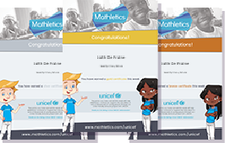
Live Mathletics: 1 correct answer = 1 point, double points in bonus level (indicated with a )
Curriculum activities: 1 correct answer = 10 points
Certificates: maximum of 1 per week
1,000 points in a week = 1 Bronze certificate
5 Bronze certificates = 1 Silver certificate
4 Silver certificates = 1 Gold certificate
Reward structure

Slide 6
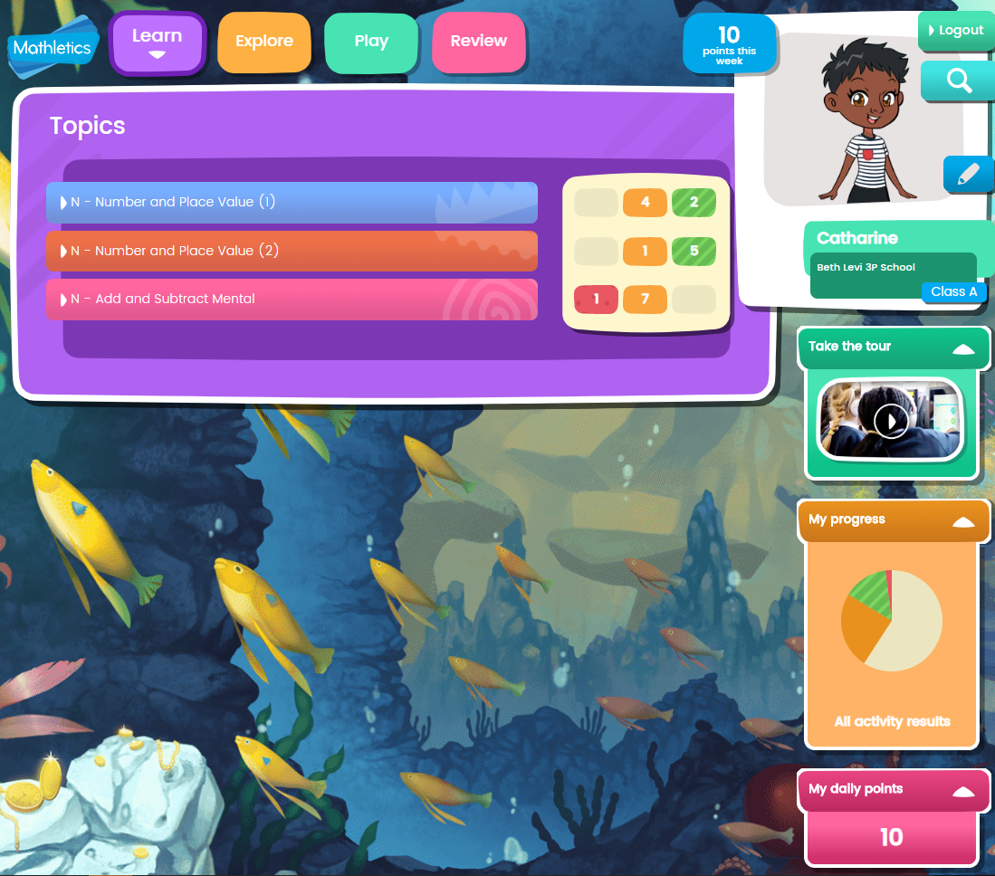
Mathletics Student Centre
Curriculum activities sorted by topic, with results indicated using Red, Amber, Green traffic light system.
Click here to personalise avatar
Pupils take control of own learning by reviewing progress here
As pupils master activities they gain Gold Bars
See points gained in a day and in a week at the top

Slide 7
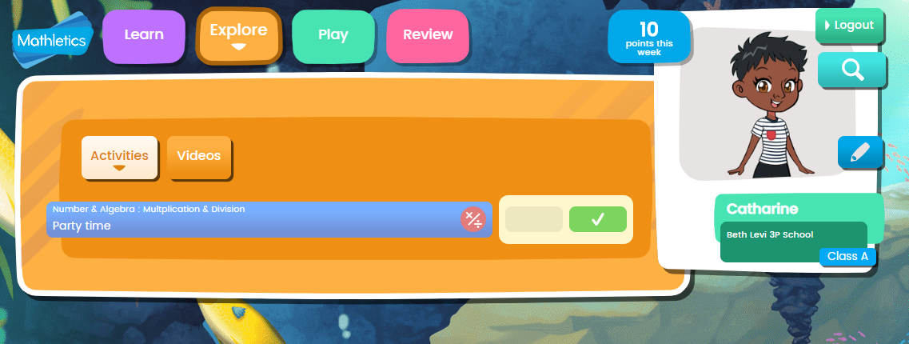
Mathletics Student Centre
Problem solving and reasoning activities:
To help students with that all-important question “how can I use this in real life?”
Videos: including times table toons and magic mentor videos!

Slide 8
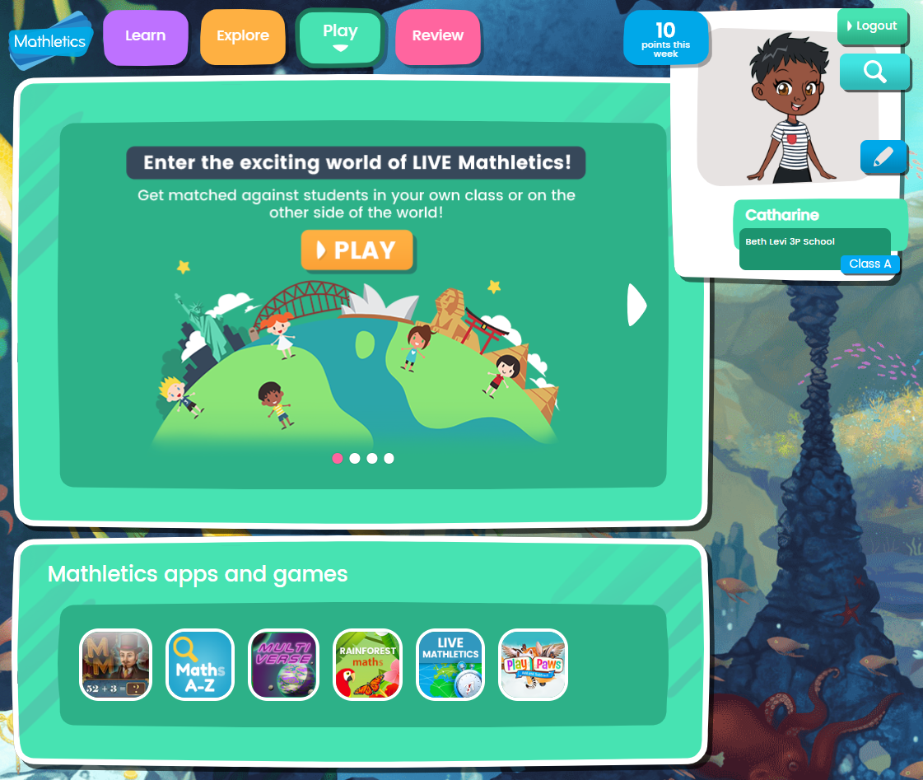
Mathletics Student Centre
Live Mathletics:
Play live maths games against children around the world to improve fluency and enjoy sense of competition
Play Paws: builds essential skills in place value, number sense, addition and subtraction.
Multiverse: an immersive game designed to increase multiplication problem-solving fluency
Rainforest Maths: Colourful scaffolded learning environment to also practice maths concepts by year group.

Slide 9
Encourage your child to access Mathletics three times a week, for 20 minutes each time
When completing activities, remind your child to use the ‘i’ help button, on the right to get a step-by-step walkthrough
Explore the different apps and games to vary their use and keep their interest high
Print and display certificates when they are achieved to reward your child
How can you help?

Slide 10
You can register for a free parent account
This will allow you to receive weekly progress reports about your child’s use of Mathletics
If you need any help with Mathletics at home, contact your school or the Mathletics Customer Support team:
support@3plearning.co.uk
0117 370 1990
Next steps

